Slide 1
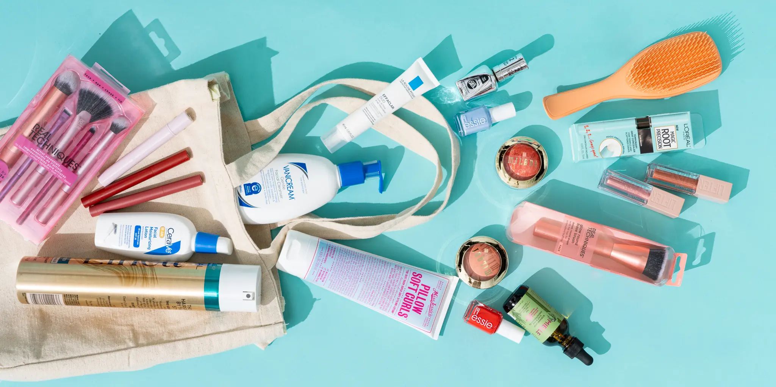
Supply Chain Analysis
By:
Mohit
Yaaz Shaikh
Rohit
Akash
OM

Slide 2

Index
Introduction
Primary goals
Insights
Recommendations & Key Takeaways

Slide 3

Introduction
We are presenting an insightful analysis on our Supply Chain Performance, focusing on key performance metrics, revenue breakdown, supplier efficiency, and logistics optimization. This study highlights crucial trends, including high profitability, inventory management challenges, and areas for operational improvement. We will explore strategies to enhance profitability, optimize supplier partnerships, reduce defect rates, and improve logistics efficiency—ultimately driving business growth. Let's dive into the key findings and recommendations that can take our supply chain to the next level.

Slide 4
Primary goals
Supply Chain Optimization

Slide 5
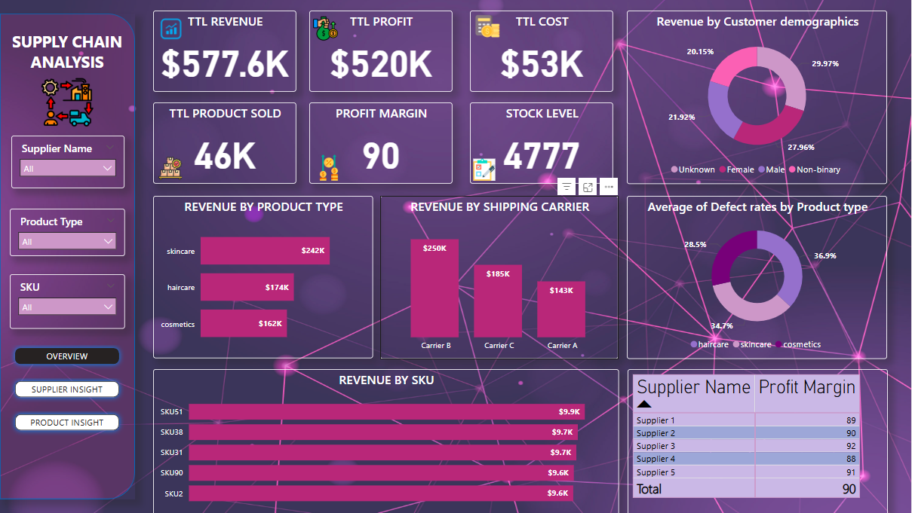
OVERVIEW

Slide 6
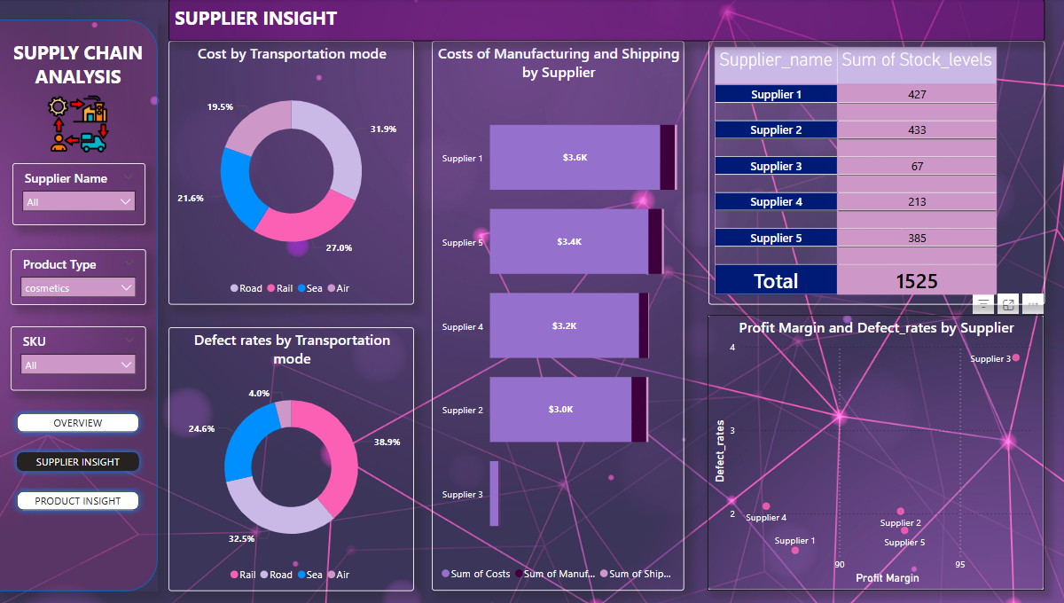
Supplier and products

Slide 7
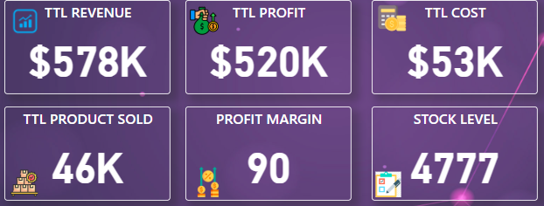
Key Performance Metrics
Total Revenue: $578K
Total Profit: $520K
Total Cost: $53K
Total Products Sold: 46K
Profit Margin: 90%
Stock Level: 4,777
Key Takeaway: High profit margin indicates efficient cost management.

Slide 8
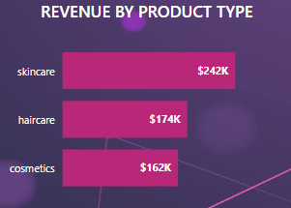
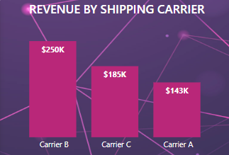
Performance Metrics
Revenue By Product Type:
Skincare: $242k (Highest)
Haircare: $174k
Cosmetics: $162k
Revenue By Shipping Carrier:
Carrier B: $250k (Highest)
Carrier C: $185k
Carrier A: $143k
Key Takeaway: Skincare is the most profitable. Optimizing logistics with Carrier B can improve margins.

Slide 9
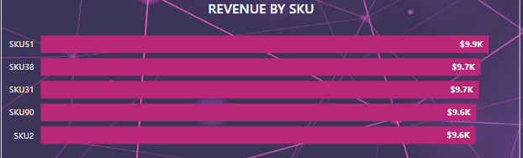
Revenue by SKU
Top SKUs:
SKU51 ($9.9K)
SKU38 & SKU31 ($9.7K each)
SKU90 & SKU2 ($9.6K each)
Key Takeaway: Balanced sales across multiple SKUs.

Slide 10
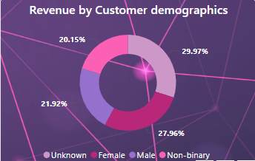
Customer Demographics
Revenue Contribution by Gender:
Male: 21.92%
Non-binary: 27.96%
Unknown:29.97%
Female: 20.15%
Key Takeaway: Understanding the "Unknown" segment can improve targeting strategies

Slide 11
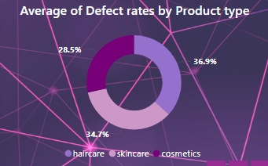
Defect Rate Analysis
By Product Type:
Haircare : 36.9% (Highest defect rate)
Skincare: 34.7%
Cosmetics : 28.5% (Lowest defect rate)
Issue: High defect rate in Haircare suggests quality control concerns.

Slide 12
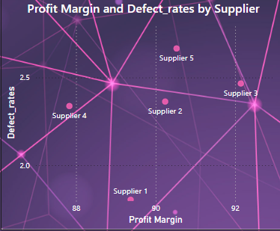
Supplier Insights
Profit Margin by Supplier:
Supplier 2 & 3: 90 (Highest)
Supplier 4: 88 (Lowest)
Defect Rate by Supplier:
Supplier 3: Highest defect rate
Supplier 1 & 4: More reliable
Key Takeaway: Supplier 3 needs quality improvement.

Slide 13
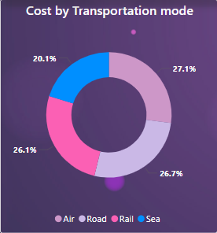
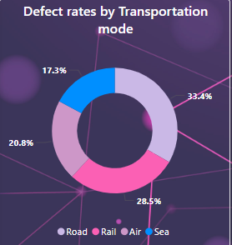
Transportation Cost & Defect Rates
Transportation Mode & Cost:
Air : 27.1% (Highest)
Road : 26.7%
Rail : 26.1%
Sea : 20.1% (Lowest)
Defect Rate by Mode:
Road : 33.4% (Highest)
Air: 17.3% (Lowest)
Key Takeaway: Reducing Road transportation can lower defect rates

Slide 14
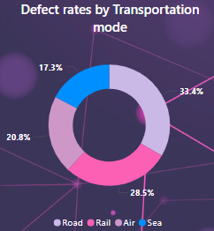
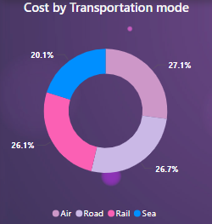
Product-Specific Supplier Insights
Cosmetics:
High defect rate (36.9%)
Supplier 3 is unreliable
Haircare:
Supplier 2 has highest costs
Road is the worst transport mode
Skincare:
Highest supplier cost ($9.2K)
Sea is the cheapest & most reliable transport

Slide 15
Recommendations & Key Takeaways
Enhance Skincare Marketing Strategies – Since it generates the highest revenue.
Optimize Logistics with Carrier B – As it contributes the most revenue.
Improve Haircare Quality Control – Due to high defect rates (36.9%).
Refine Customer Data Collection – 29.97% of customers fall under "Unknown."

Slide 16
Elon Musk”
"Supply chain is like the back wheel of a bicycle without it, the front wheel doesn’t move."

Slide 17
Thank you

